Slide 1
PART-4

Slide 2


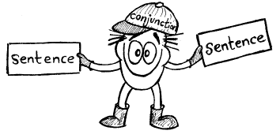
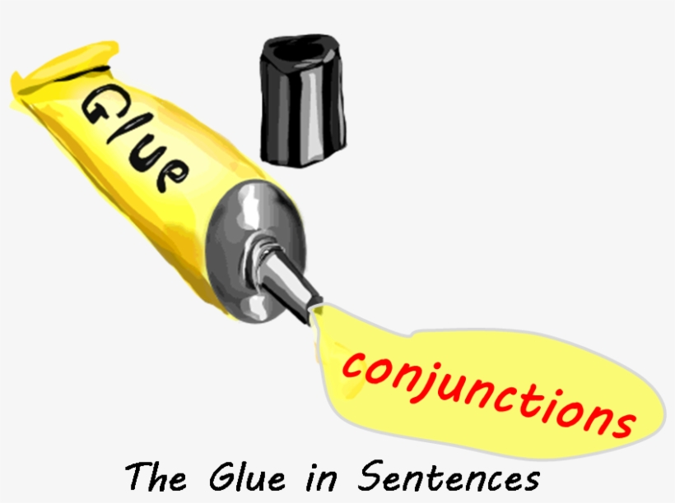

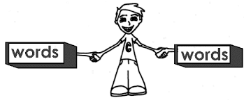
CONJUNCTION
A conjunction joins words, phrases, or clauses, and indicates the relationship between the elements joined. For ex:
‘The man is poor, but he is honest.’

Slide 3
Poll Question:-
What is the conjunction in the following sentence?
Luke Skywalker and Han Solo set out to rescue Princess Leia.
A. Set
B. Rescue
C. And
D. To

Slide 4
Answer
OPTION -C

Slide 5
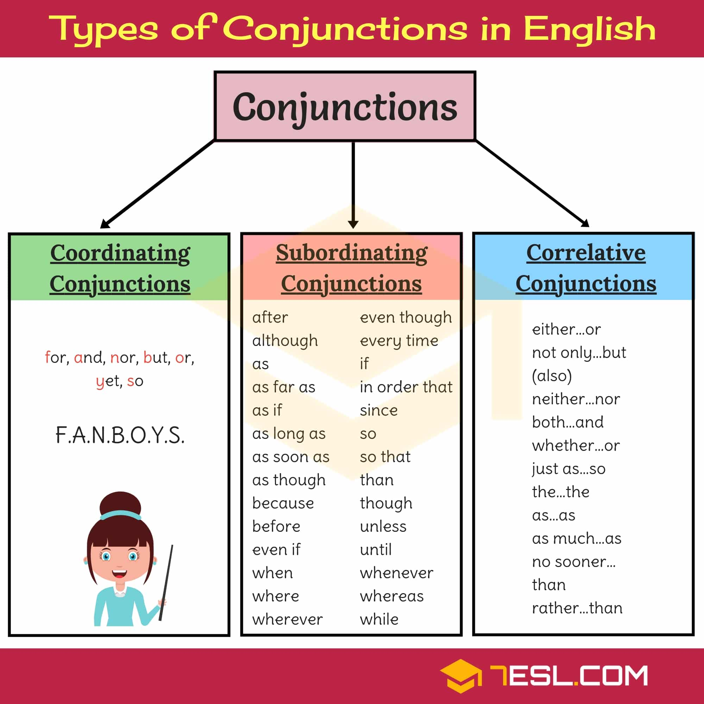

Slide 6
Poll Question:-
The two types of conjunctions are:
A. Contrasts and Contradictions
B. Complete and Incomplete
C. Coordinating and Subordinating
D. Words of the Wiser

Slide 7
Answer
OPTION- C

Slide 8

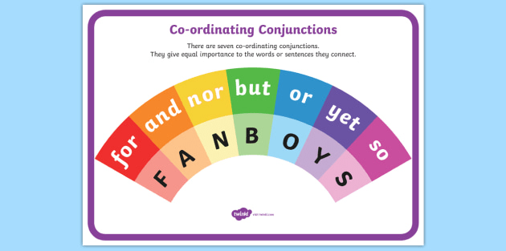
Coordinating conjunctions
Coordinating conjunctions join words, phrases or clauses having similar grammatical structure. There are seven coordinating conjunctions.
It joins the following:
word + word
phrase + phrase
clause + clause

Slide 9
For Example:-
They kicked and punched him. (connecting words)
The mother bought her a strawberry ice cream and a bear lollipop. (connecting phrases)
He left early, for he had to be on time for the meeting
There were only small beans in the soup but delicious.
He had been crying all day, yet the man made him
laugh. (connecting clauses)

Slide 10
Poll Question:-
How many coordinating conjunctions are there?
A. 6
B. 5
C. 7
D. 8

Slide 11
Answer
OPTION- C

Slide 12
Poll Question:-
What does the acronym FANBOYS stand for?
A. For, And, Nor, But, Yet, Since
B. Finally, After, Neither, Once, Yet, Since
C. For, And, Nor, Because, Or, Yet, So
D. For, And, Nor, But, Or, Yet, So

Slide 13
Answer
OPTION- D

Slide 14
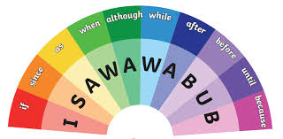
Subordinating conjunction
Subordinating conjunction joins a subordinate (dependent) clause to main (independent) clause. A main clause is a group of words having a subject and a verb and can stand alone as a sentence. On the other hand, the subordinate clause cannot stand alone as a sentence and it does not give a complete meaning.

Slide 15
For Example:-
She has aged a lot since the last time we met.
Even though she is quite fat, she can run quickly
upstairs.
When the doorbell rang, my dog Skeeter barked loudly.
Sara begins to sneeze whenever she opens the window to get a breath of fresh air. You will pass if you work hard.

Slide 16
Poll Question:-
A subordinating conjunction at the beginning of a sentence will require a comma after the first complete thought.
A. True
B. False

Slide 17
Answer
OPTION- A

Slide 18
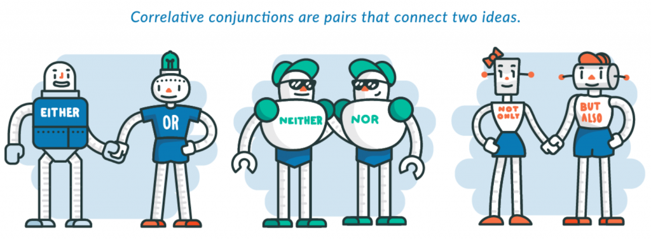
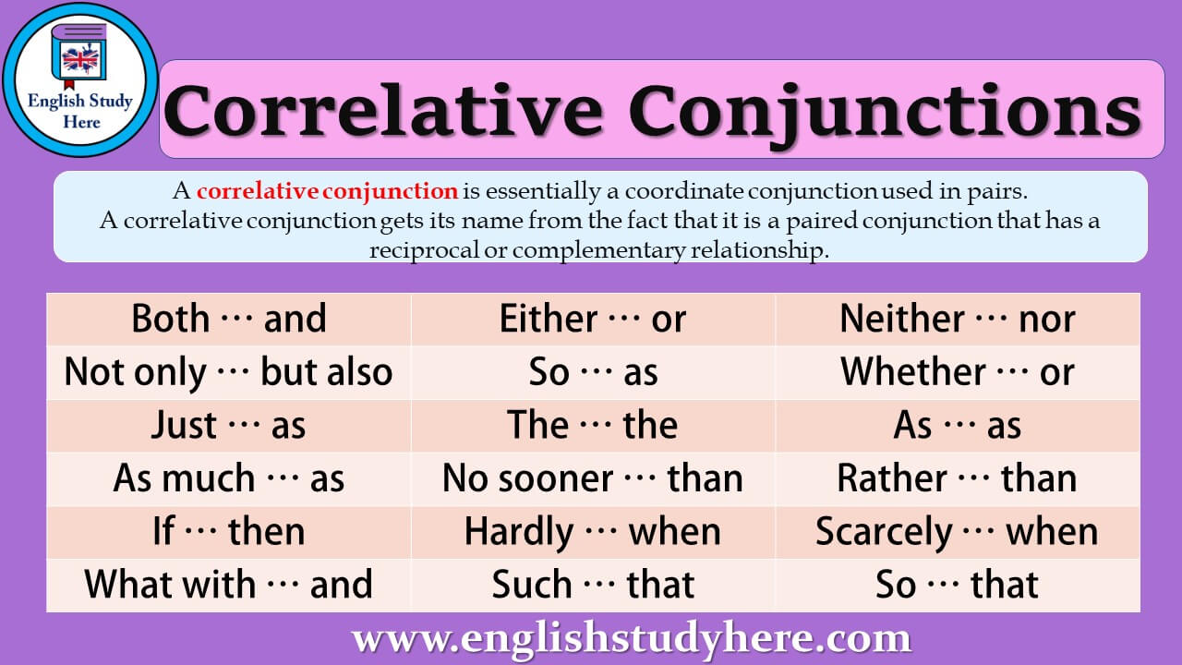
Correlative Conjunctions
Correlative conjunctions are paired conjunctions. They connect two words, phrases or clauses: i.e.

Slide 19
For Example:-
Either John or Johnny plays as goalkeeper in the match
Neither Debra nor Sally expressed her annoyance when the cat broke the lamp.
Not only did Mary grill burgers for Michael, but she also fixed a steak for her dog
I don’t care whether you go or stay.
She is interested not only in singing but also in games

Slide 20
Poll Question:-
Decipher which type of conjunction is being used in the following sentences:
You can either eat chicken or salad at dinner.
A. Correlative
B. Coordinating
C. Subordinating
D. None of the above

Slide 21
Answer
OPTION- A

Slide 22
The Memory Circle Game
Ask your pupils to say something they like and something they don’t like, or two thing they like or dislike.
For example, “I like fishes but I don’t like shrimps”.
Make sure that pupil make full sentences in order to practice conjunctions. Then ask the next student to say: “He/she likes fishes but he/she doesn’t like shrimps,” and then the next student add something of his or her own, for example “I like cats and cars”.
The game goes on until everyone has had a chance to speak, but if someone can’t remember, they are out.

Slide 23
Think:::::::::::::::::::::::::::::::::::::
What part of speech comes to mind when you hit your thumb with a hammer?
Or spill water on your cell phone?

Slide 24
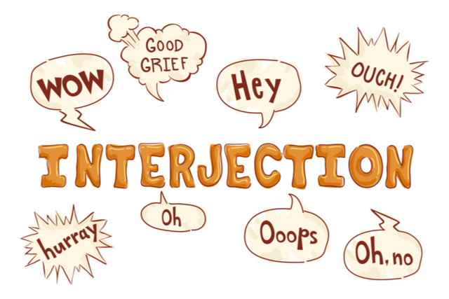

Slide 25
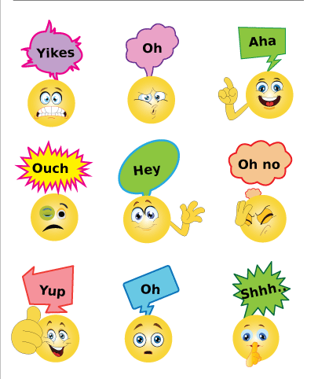
INTERJECTION
Interjections are words used to express strong feeling or sudden emotion. They are included in a sentence (usually at the start) to express a sentiment such as surprise, disgust, joy, excitement, or enthusiasm.

Slide 26
Poll Question:-
Interjections are used to express a sentiment such as surprise, disgust, joy, excitement, or enthusiasm.
A. True
B. False

Slide 27
Answer
OPTION- A

Slide 28
Examples of Interjections
Hey! Get off that floor!
Good! Now we can move on.
Wow! That boat is big!
Alas! The city has been captured!
Aah! The monster’s got me!

Slide 29
Poll Question
An Interjection is :
A. A word used to modify a verb or an adjective.
B. A word used to express strong feeling or strong emotion.
C. A word used to connect two clauses.
D. A word which is used to place before a noun or a pronoun

Slide 30
Answer
OPTION -B

Slide 31
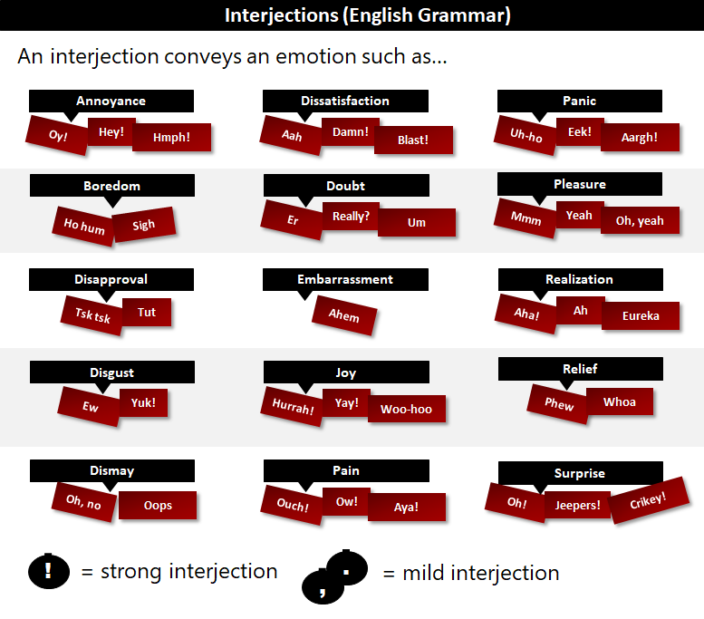
Kinds of Interjections

Slide 32
Poll Question
Select the interjection:
A. Only
B. On
C. Oh
D. And

Slide 33
Answer
OPTION- C

Slide 34
Position of Interjection in a sentence
Interjections do not always have to be at the beginning of a sentence. They can appear in the middle, at the end, or anyplace else where the author wants to interject a bit of feeling and emotion.
For example, in the sentence “So, it’s snowing again, huh?”
Here, the interjection is designed to express confusion (or perhaps dismay) at the continued snow falling. In this sentence, the emotion wasn’t an emotion that necessitated an exclamation point instead, the interjection ‘huh’ turned the sentence into a question.

Slide 35
Some interjections are sounds. For Example:
Phew! I am not trying that again.
Humph! I knew that last week.
Mmmm, my compliments to the chef.

Slide 36
Let’s see more examples in detail.
1. Aah
Aah meaning and Aah interjection examples:
Expressing pleasure: “Aah, that’s great!”
Expressing realization: “Aah, now I see what you mean.”
Expressing resignation: “Aah, I give up!
Expressing surprise/shock: “Aah! It’s eating my leg!”

Slide 37
2. Ah
Ah meaning and Ah interjection examples:
Expressing pleasure: “Ah, this coffee is good.”
Expressing realization: “Ah, now I understand.”
Expressing resignation: “Ah!Well, I’ll have to come back tomorrow.”
Expressing surprise: “Ah! There you are!”

Slide 38
Poll Question
Does this sentence include an interjection: I am so excited for Friday night!
A. Yes
B. No

Slide 39
Answer- No

Slide 40
3. Alas
Alas meaning: Expressing grief or pity
“Alas! My only son has died.
4. Aha
Aha meaning: Understanding, triumph
“Aha! So you planned all this, did you?”

Slide 41
5. Aw, Aww
Aw, Aww meaning and examples:
Expressing mild disappointment or protest: “Aw, come on, Andy!”
Shows sentimental approval: “Aww! Just look at that kitten.”
Feeling sorry or pity for someone: “Aww, that’s so sad, he hasn’t yet learned to ride a bike.”

Slide 42
6. Ahem
Ahem meaning: The sound of clearing one’s throat. Used to get someone’s attention, especially if they don’t know (or apparently forgot) that you’re there.
“Ahem! Can I make a suggestion?”
7. Bingo
Bingo meaning: Acknowledge something as right
“Bingo! That’s the one I’ve been looking for.”

Slide 43
Poll Question
Which of the following words are not interjections?
Feel
Bingo
Shoo
Wow

Slide 44
Answer-A

Slide 45
8. Boo
Boo meaning and Boo interjection examples:
Expressing disapproval, contempt: “Boo!” they shouted, “Get off!”
A noise used to scare people by surprise: “I jumped out from the closet and yelled “boo!”
9. Bravo
Bravo meaning: Expressing approval
“Bravo, Rena! You’re right.”

Slide 46
10. Bah
Bah meaning: Expressing dismissive or annoyed
“Bah, I never liked him anyways.”
11. Dear
Dear meaning and Dear interjection examples:
Expressing pity: “Oh dear! I’ve lost my keys again.”
Expressing surprise:v“Dear me! What a mess!”

Slide 47
Poll Question
Select the sentence with an interjection:
A. That’s another fine mess you’ve gotten me into?
B. Oh dear! What are we going to do about this mess?

Slide 48
Answer -B

Slide 50
14. Er
Er meaning: Expressing hesitation
“Lima is the capital of…er…Peru.”
15. Eww
Eww meaning: Expressing disgust, dislike
“Eww, there’s a fly in my lemonade!”

Slide 51
Poll Question:-
Select the interjection that expresses hesitation:
A. Er.
B. Yes
C. Alas
D. Hurray

Slide 52
Answer-A

Slide 53
16. Gee
Gee meaning: Expressing surprise, enthusiasm, or just general emphasis
“Gee, , what a great idea!”
17. Grr
Grr meaning: Expressing anger, snarling, growling. Often used for dogs and other animals
“Grrr, I’ll hit your head!”

Slide 54
18.Huh
Huh meaning: Mild, indifferent surprise
“Huh, you were right.”
19. Humph
Humph meaning: A snort, to express dislike, disbelief or annoyance
“Humph! That makes me so upset! The kitten is so mean!”

Slide 55
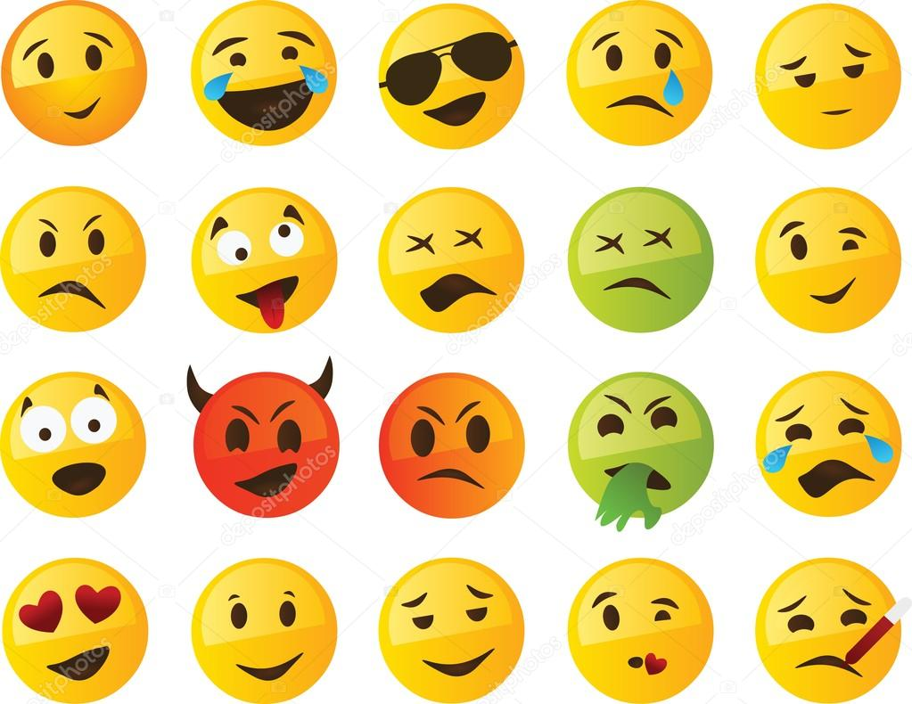
Activity-Analyze the emotions/expressions of the given pictures and use the same in the sentences of your own using appropriate interjections:

Slide 56
20. Hurrah
Hurrah meaning: Generic exclamation of joy
“We’ve done it! Hurrah!”
21. Mhm
Mhm meaning: Agreement, acknowledgement
“Do you think so too?” “Mhm!”

Slide 57
Poll Question
_____! You made an A+ on the test.
No
Oops
Hmmm
Hooray

Slide 58
Answer -D

Slide 59
22. Oh
Oh meaning and Oh interjection examples:
Expressing realization: “Oh, you scared me.”
Expressing surprise: “Oh, how wonderful!”
Expressing pain: “Oh! I have a terrific headache.”
Expressing pleading: “Oh, please, you must believe me.”

Slide 60
23. Oops
Oops meaning: Being surprised at or acknowledging your own mistakes
“Oops! I did it again!”
24. Oww
Oww meaning: Expressing pain
“Oww, you stepped on my foot!”

Slide 61
25. Ouch
Ouch meaning: Exclamation of pain
“Ouch, that hurt! Stop pinching me!”
26. Pew
Pew meaning: Used for foul odors
“Pew, this blanket smells a bit fusty.”

Slide 62
Poll Question.
"_____! You're stepping on my foot."
Ah
Oh
Ouch
Well

Slide 63
Answer -C

Slide 64
27. Phew
Phew meaning: Expressing relief
“Phew, I’m glad that’s all over”
28. Um, Umm
Um, Umm meaning: Expressing hesitation
“85 divided by 5 is…um…17.”

Slide 65
29.Whoa
Whoa meaning: Can be used to suggest caution as in here, and also stereo typically used by marijuana smokers to express dumbfounded amazement (“whoa, look at the colors!”). Originally a sound used to make horses stop.
“Whoa, take it easy!”
30. Wow
Wow meaning: Impressed, astonished
“Wow! Holy cow! That’s great!”

Slide 66
31. Well
Well meaning and well interjection examples:
Expressing surprise: “Well, so Steve got the job?”
Introducing a remark: “Well, what did he say?”
32. Yahoo
Yahoo meaning: Generic exclamation of joy
“Yahoo, we did it!”

Slide 67
Which sentence correctly uses an interjection?
Well, something is better than nothing.
Well! !something is better than nothing.
Well. Something is better than nothing.
Well, Something is better than nothing.

Slide 68
Answer-A

Slide 69
33. Yikes
Yikes meaning: Fear and alarm.
“Yikes, my mother’s home!”
34. Yippee
Yippee meaning: Exclamation of celebration
“No school for five weeks – yippee!”

Slide 70
35. Yuck
Yuck meaning: Disgust, dislike
“Yuck! I hate mayonnaise.”
36. Tsk-tsk
Tsk-tsk meaning: Expressing disappointment or contempt
“Tsk-tsk, I think you’re wrong about that.”

Slide 71
37. Shoo
Shoo meaning: Used to drive away animals or small children
“Shoo, all of you, I’m busy!”

Slide 72
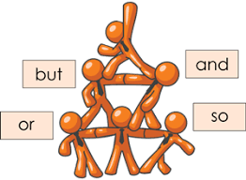
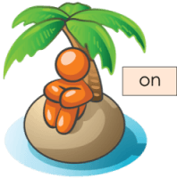
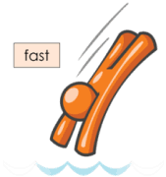
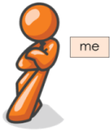
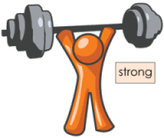
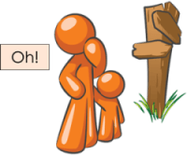
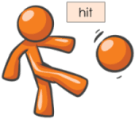
Activity- Make students presenter & ask them to name different parts of speech from the following pictures.

Slide 73
“Start today by imagining the life you want in the future and taking one practice step towards it………..”
THANK YOU

